Slide 1
Chapter 2: Introduction to Relational Model

Slide 2
Structure
Schema
Query language
Relational alegbra

Slide 3
Data Models
A collection of tools/constructs for describing
  Data
  Data relationships
  Data constraints
Relational model
Object-based data models (Object-oriented and Object-relational)
Other older models:
  Network model
  Hierarchical model
Notes:
Semistructured data model (XML)
a three-dimensional representation of a person or thing or of a proposed structure, typically on a smaller scale than the original.

Slide 4

Basic Unit of the Relational Model
Example of a Relation/Table:
attributes
(or columns)
tuples
(or rows)

Slide 5
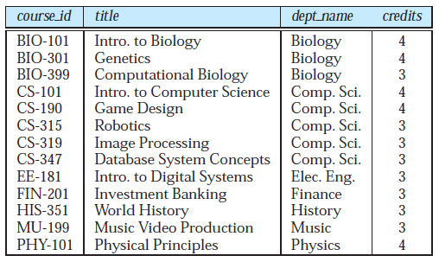
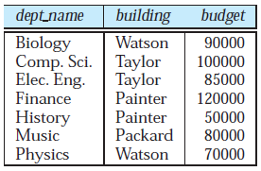
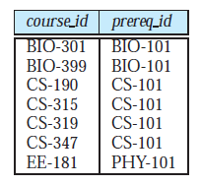
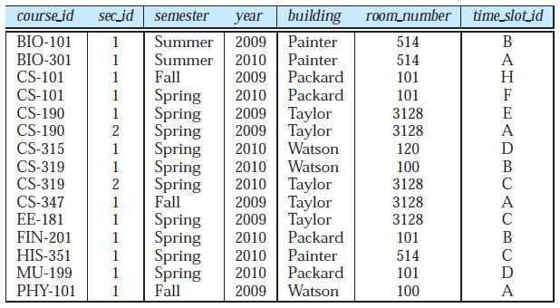
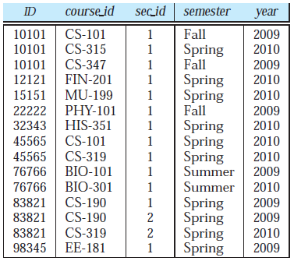

Slide 6
Table/Relation
In general, a row in a table represents a relationship among a set of values.
In the relational model the term relation is used to refer to a table, while the term tuple is used to refer to a row.
Similarly, the term attribute refers to a column of a table.
The term relation instance is used to refer to a specific instance of a relation, i.e., containing a specific set of rows.

Slide 7
Attribute Types
The set of permitted values for each attribute is called the domain of the attribute.
Attribute values are (normally) required to be atomic; that is, indivisible
The null value is a special value that signifies that the value is unknown or does not exist
Notes:
Phone no. example for Atomic

Slide 8
Relation Schema and Instance
The term relation schema is attribute set and their domains
whereas the relation instance corresponds to the values which the variable takes.
A relation schema syntax: R = (A₁ :D1, A₂ :D2, …, A_{n} :Dn )
Example:
instructor = (ID: int, name :String, dept_name : String, salary: float)
A database consists of multiple relations

Slide 9

Relations are Unordered
Order of tuples is irrelevant (tuples may be stored in an arbitrary order)
Example: instructor relation with unordered tuples

Slide 10
Database
A database consists of multiple relations
Information about an enterprise is broken up into parts
instructor
student
advisor
Bad design: Putting everything in one table
univ (instructor -ID, name, dept_name, salary, student_Id, ..)
results in
  repetition of information (e.g., two students have the same instructor)
  the need for null values (e.g., represent an student with no advisor)
Normalization theory (Chapter 7) deals with how to design “good” relational schemas

Slide 11
Keys
The values of the attribute values of a tuple must be such that they can uniquely identify the tuple.
A superkey is a set of one or more attributes that, taken collectively, allow us to identify uniquely a tuple in the relation.
K is a superkey of R if values for K are sufficient to identify a unique tuple of each possible relation r(R)
  Example: {ID} and {ID, name} are both superkeys of instructor.

Slide 13
Superkey K is a candidate key if K is minimal
Example: {ID} is a candidate key for Instructor
It is possible that several distinct sets of attributes could serve as a candidate key.
Suppose that a combination of name and dept_name is sufficient to distinguish among members of the instructor relation. Then, both {ID} and {name, dept_name} are candidate keys.

Slide 14
Keys
Candidate key
Primary Key
Super key (Non minimal Key)
Foreign Key

Slide 15
Candidate and Primary Key
The attributes ID and name together can distinguish instructor tuples, their combination, {ID, name} does not form a candidate key, since the attribute {ID} alone is a candidate key.
One of the candidate keys is selected to be the primary key.
The primary key should be chosen such that its attribute values are
never, or very rarely changed and it should not have null value.
It is customary to list the primary key attributes of a relation schema before the other attributes.
Primary key attributes are also underlined

Slide 16
Foreign Key
A relation, say r1, may include the primary key of another relation, say r2. This attribute is called a foreign key from r1, referencing r2.
Referencing relation – r1
Referenced relation – r2
For example, the attribute dept_name in instructor is a foreign key from instructor, referencing department.

Slide 17
DEPARTMENT
INSTRUCTOR
Referencing relation – r1- INSTRUCTOR
Referenced relation – r2- DEPARTMENT

Slide 18
Example of a Database
(with a Conceptual Data Model)
Mini-world for the example:
  Part of a UNIVERSITY environment.
Some mini-world entities:
  STUDENTs
  COURSEs
  SECTIONs (of COURSEs)
  (academic) DEPARTMENTs
  INSTRUCTORs
Slide 1- <number>

Slide 19
Example of a Database
(with a Conceptual Data Model)
Some mini-world relationships:
  SECTIONs are of specific COURSEs
  STUDENTs take SECTIONs
  COURSEs have prerequisite COURSEs
  INSTRUCTORs teach SECTIONs
  COURSEs are offered by DEPARTMENTs
  STUDENTs major in DEPARTMENTs
Note: The above entities and relationships are typically expressed in a conceptual data model, such as the ENTITY-RELATIONSHIP data model (see Chapters 3, 4)
Slide 1- <number>

Slide 20

Example of a simple database
Slide 1- <number>

Slide 21

Schema Diagram for University Database

Slide 22
Schema
classroom(building, room_number, capacity)
department(dept_name, building, budget)
course(course_id, title, dept_name, credits)
instructor(ID, name, dept_name, salary)
section(course_id, sec_id, semester, year, building, room_number, time_slot_id)
teaches(ID, course_id, sec_id, semester, year)

Slide 23
student(SID, name, dept_name, tot_cred)
takes(SID, course_id, sec_id, semester, year, grade)
advisor(sID, iID)
Time_slot(time_slot_id, day, start_time, end_time)
prereq(course_id, prereq_id)

Slide 24
TEACHES

Slide 25
Relational Query Languages
A query language is a language in which a user requests information from the database.
Categorized as procedural or non procedural
Procedural: The user instructs the system to perform a sequence of operations on the database to compute the desired result.
Nonprocedural: user describes the desired information without giving a specific procedure for obtaining that information.
Notes:
Non- procedural, or declarative: the user describes the desired information without giving a specific procedure for obtaining that information.

Slide 26
In a procedural query language, like Relational Algebra, you write a query as an expression consisting of relations and Algebra Operators, like join, cross product, projection, restriction, etc.
On the contrary, query SQL are called “non procedural” since they express the expected result only through its properties, and not the order of the operators to be performed to produce it

Slide 27
Relational Operations
The result of a query is a new relation that is a subset of the original relation
SELECTION
1. Selecting certain tuples
if we select tuples from the instructor relation satisfying the predicate “salary is greater than $85000”

Slide 28
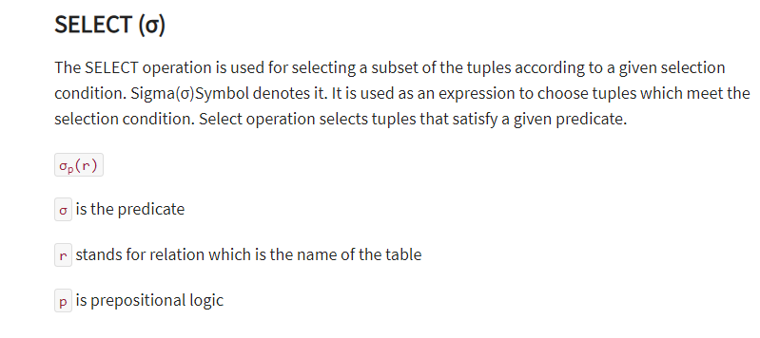

Slide 29
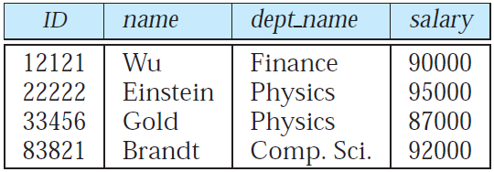

Slide 30

Selection of tuples
Relation r
Select tuples with A=B and D > 5
σ _{A=B and D > 5} (r)
Notes:
Relational algebra is a procedural query language, which takes instances of relations as input and yields instances of relations as output. It uses operators to perform queries. An operator can be either unary or binary

Slide 31

Selection of Columns (Attributes)
Relation r:
Select A and C
  Projection
  Π _{A, C} (r)

Slide 32

PROJECTION: Selecting few attributes/columns
Write the query for this output

Slide 33

Cartesian Product
Combines all tuples from two relations
Relations r, s:
r x s:

Slide 34

Natural Join- Example
The natural join operation on two relations matches tuples whose values are the same on all attribute names that are common to both relations.
Relations r, s:
Natural Join
  r s

Slide 35

JOIN operation
Joins two relation on a COMMON attribute

Slide 36

Union of two relations
Relations r, s:
r ∪ s:

Slide 37

Set difference of two relations
Relations r, s:
r – s:

Slide 38

Set Intersection of two relations
Relation r, s:
r ∩ s

Slide 39

Figure 2.06

Slide 40

Figure in-2.1

Slide 41
End of Chapter 2

Slide 42
Figure 2.01

Slide 43

Figure 2.02

Slide 44

Figure 2.03

Slide 45
Figure 2.04

Slide 46

Figure 2.05

Slide 47

Figure 2.07

Slide 48

Figure 2.10

Slide 49
Figure 2.11

Slide 50
Figure 2.12

Slide 51

Figure 2.13

